Slide 1
Steps for using SciENcv

Slide 2
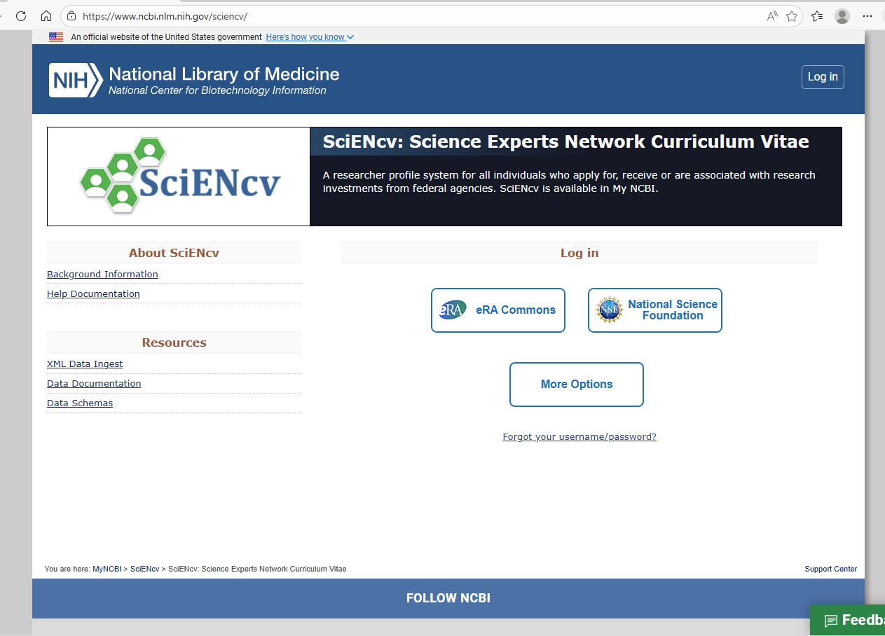
Creating a log in
Create a log in.
I used my ORCID account which makes it easier to transfer publications already in this account

Slide 3
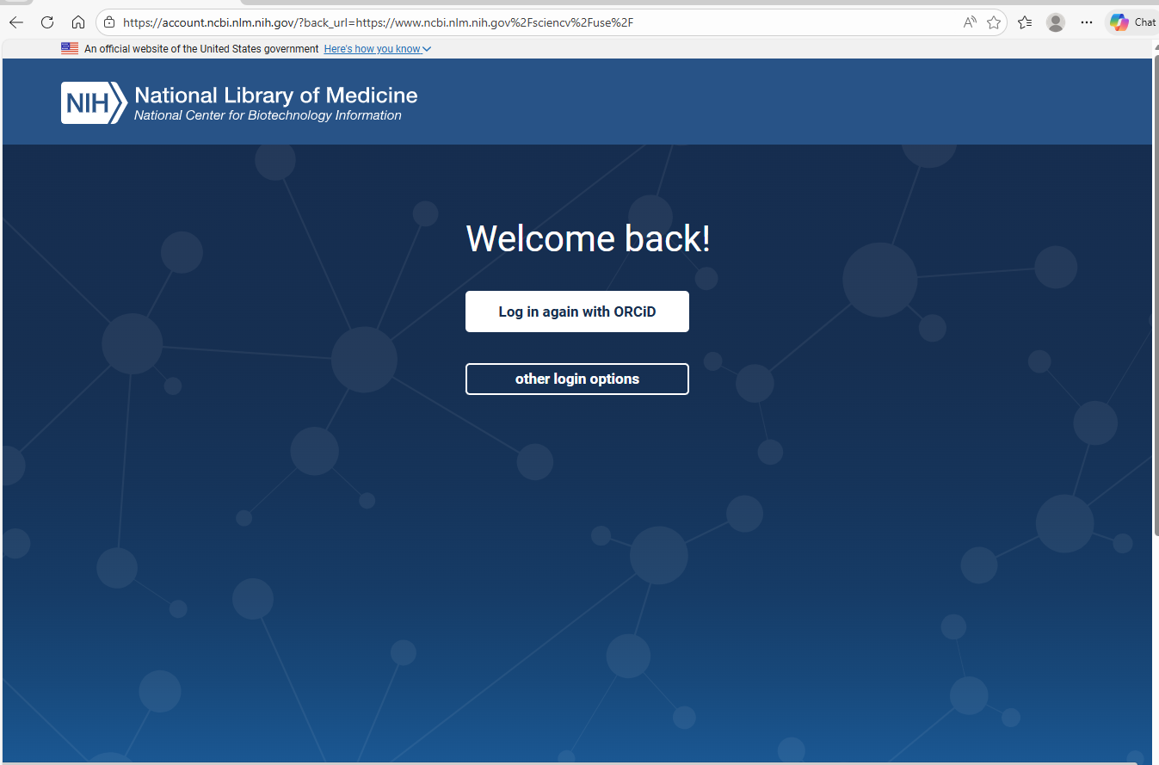
Log in

Slide 4
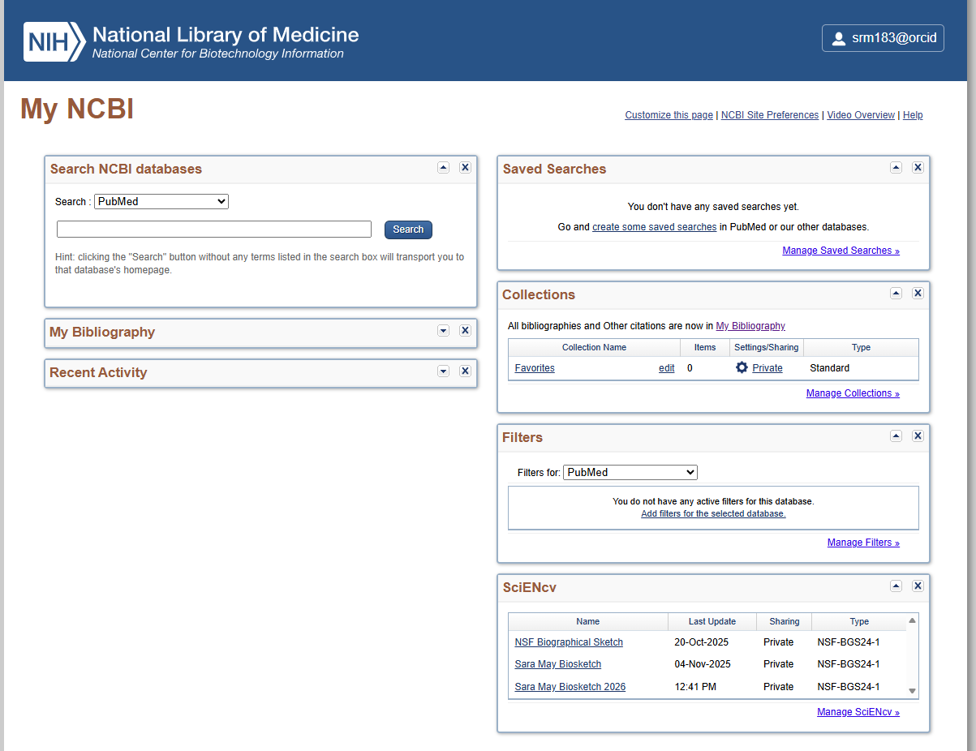
SciENcv Home page
Once logged in it takes you to this page with lots of boxes. Click on Manage SciENcv

Slide 5
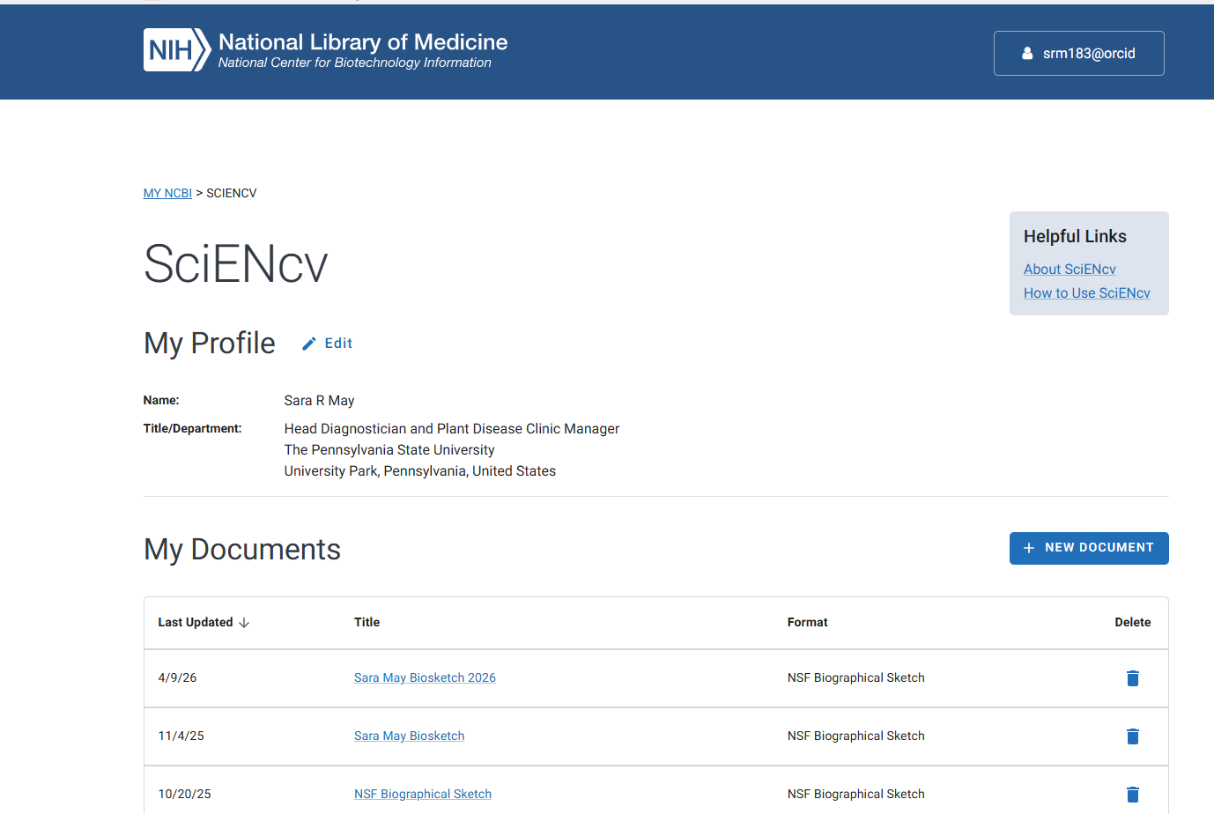
Adding a new document 1
Click on New Document to make a new biosketch or current and pending etc…

Slide 6
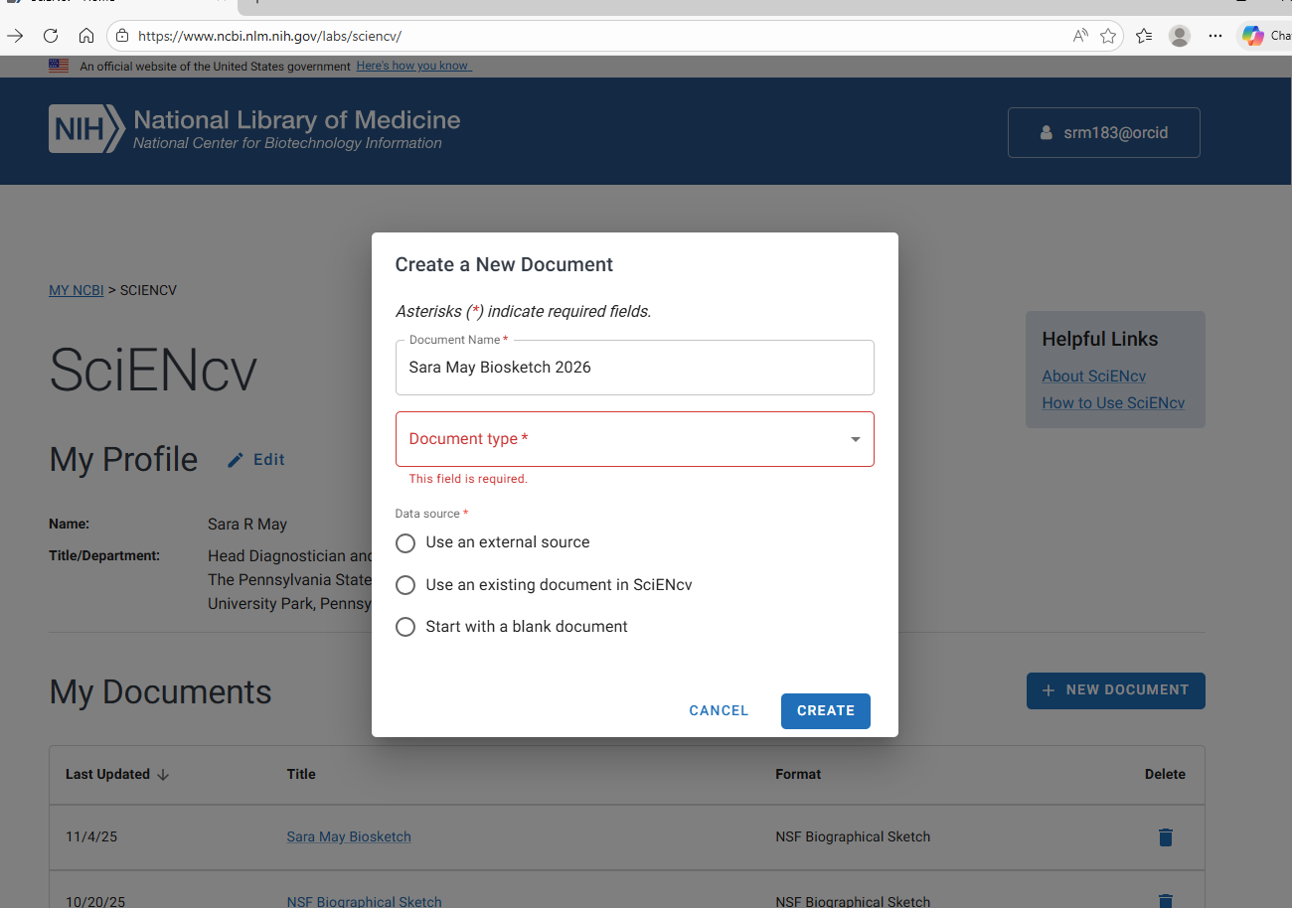
Adding a new document 2
Name the new document

Slide 7
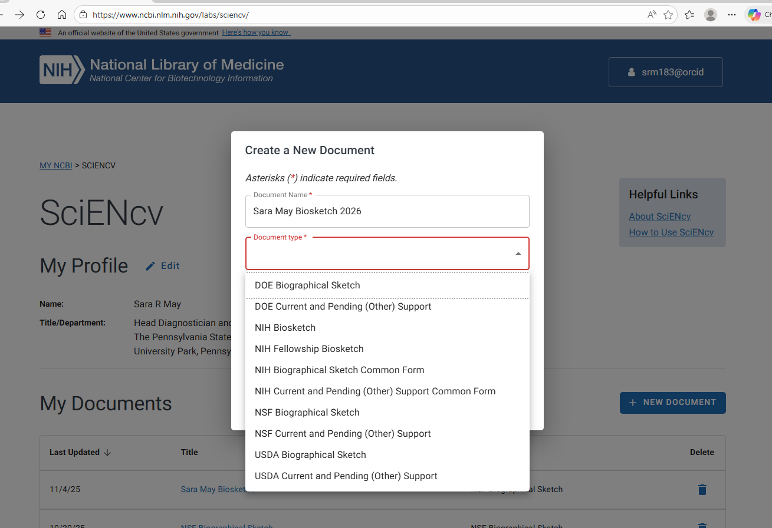
Adding a new document 3
Select the type of document from the dropdown

Slide 8
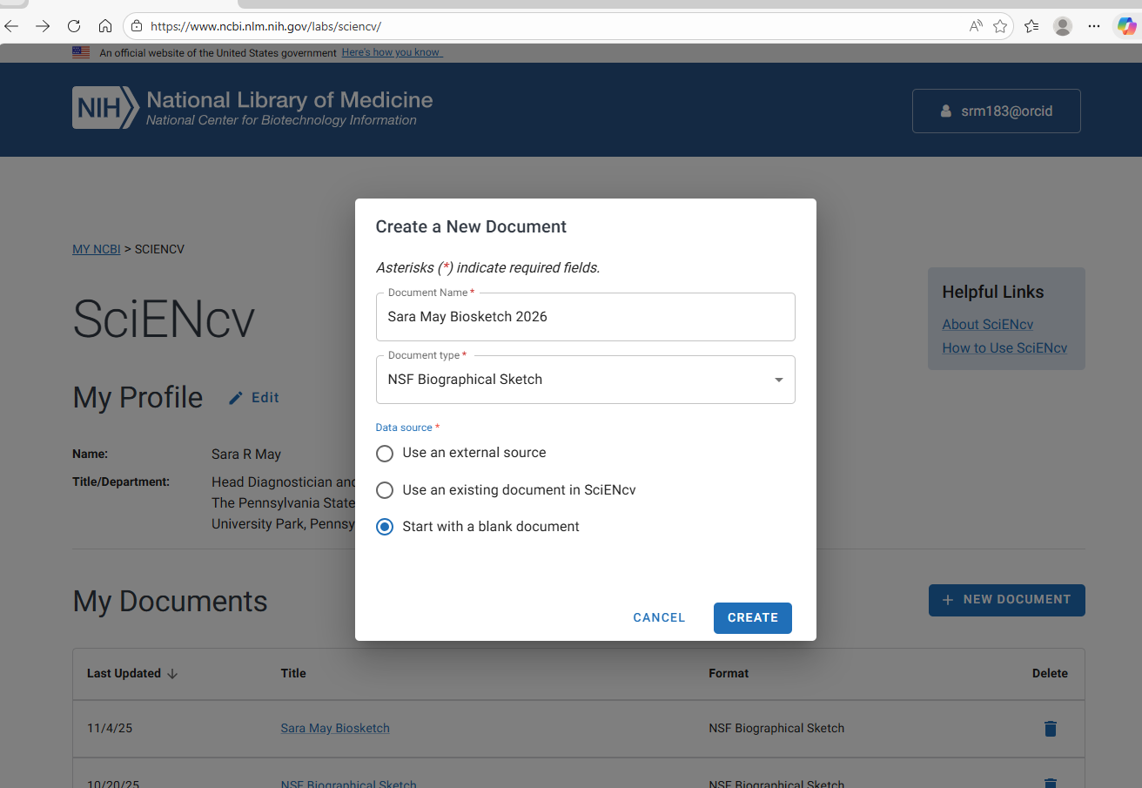
Adding a new document 4
Start from a blank document or once you have created some you can use an existing document

Slide 9
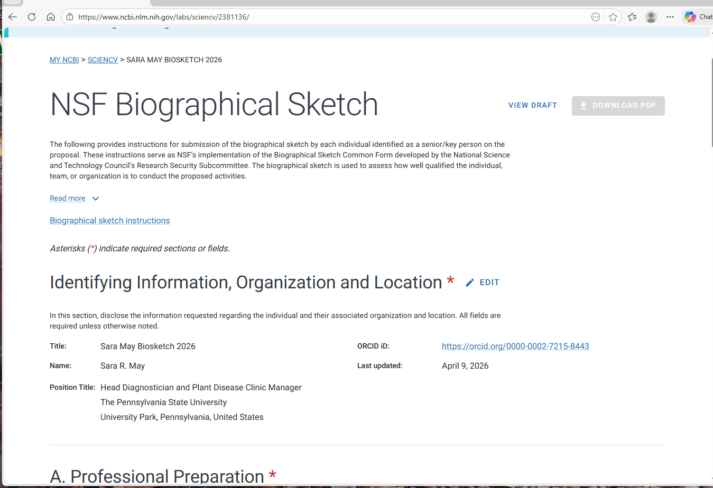
NSF Bio Sketch

Slide 10
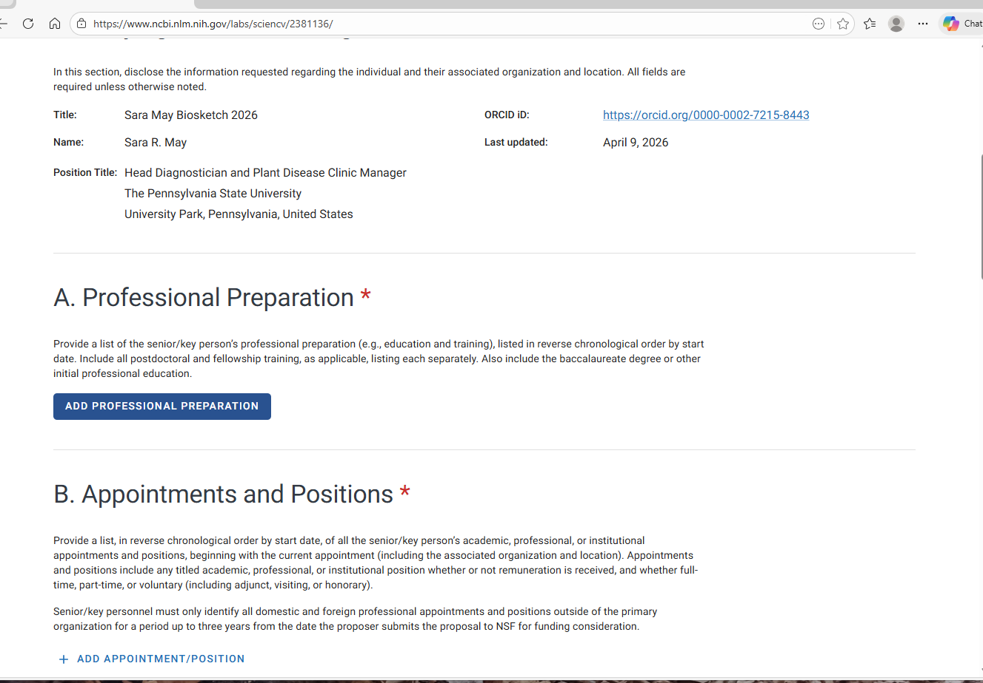
Adding professional preparation 1

Slide 11
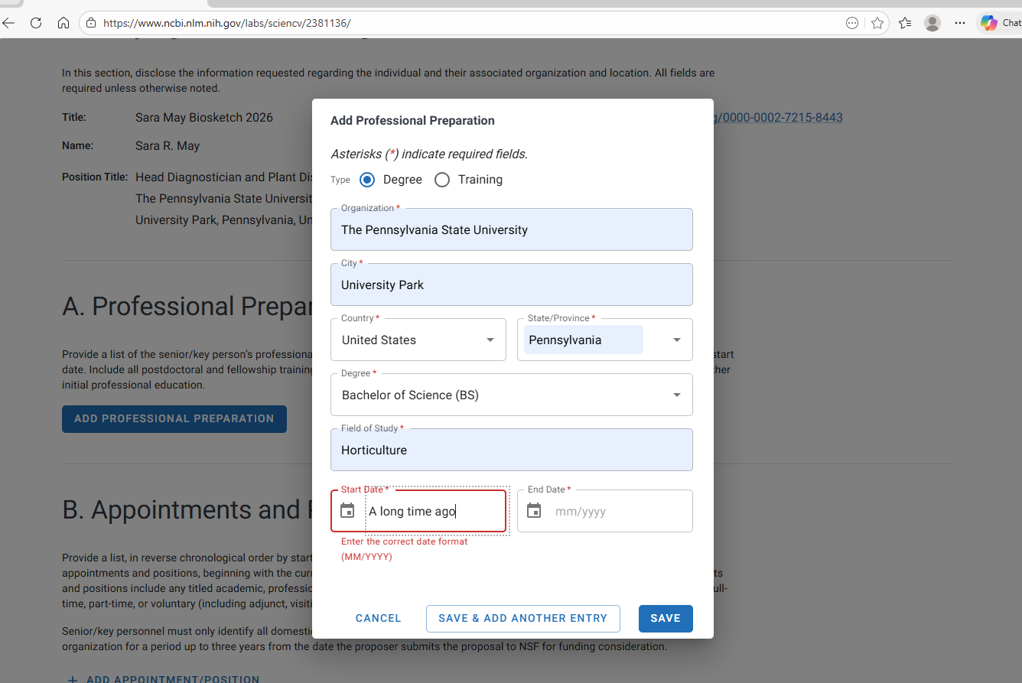
Adding professional preparation 2
Fill in information for your degree(s) and appointments

Slide 12
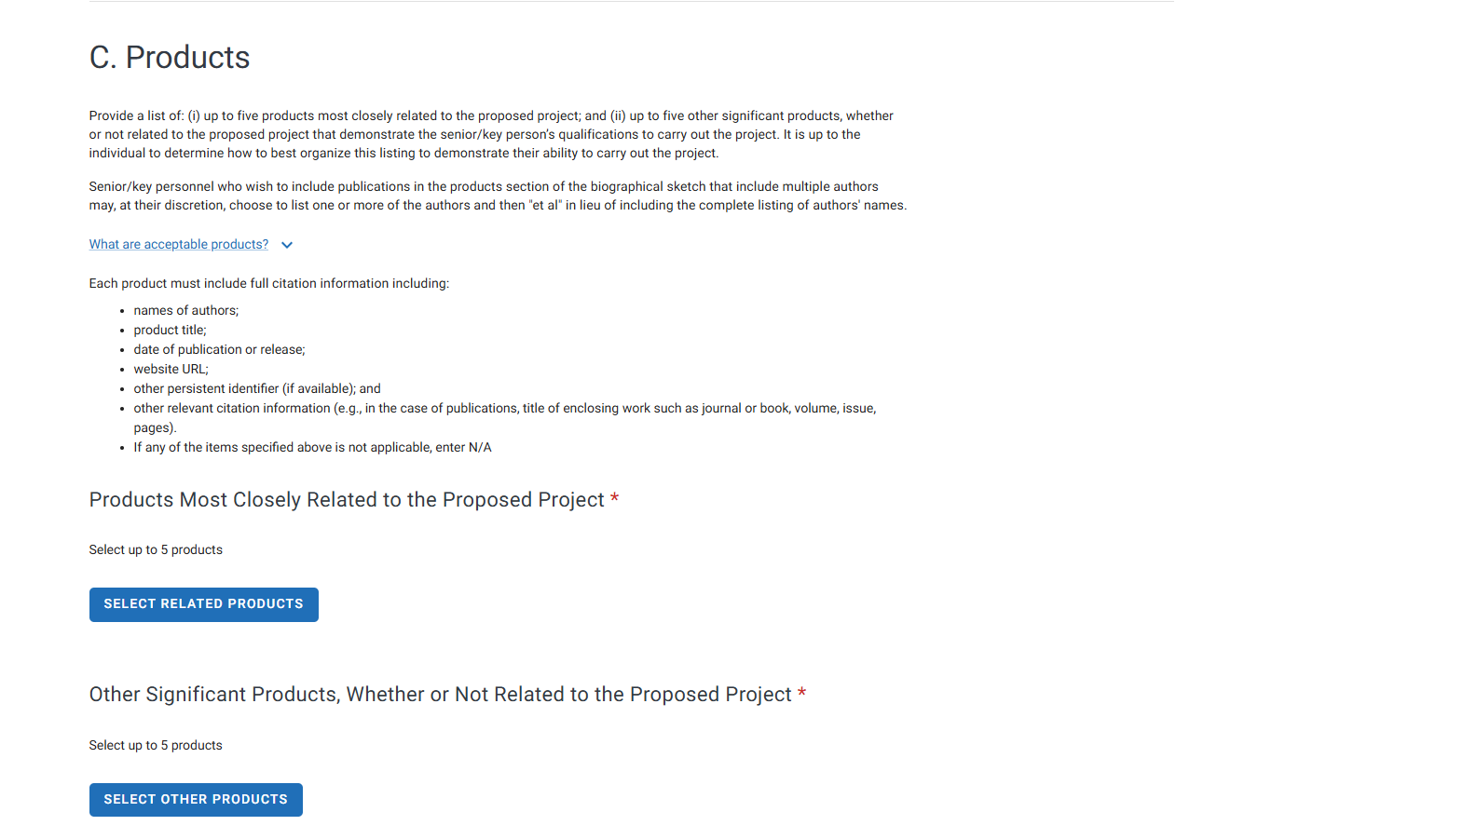
Adding products 1

Slide 13
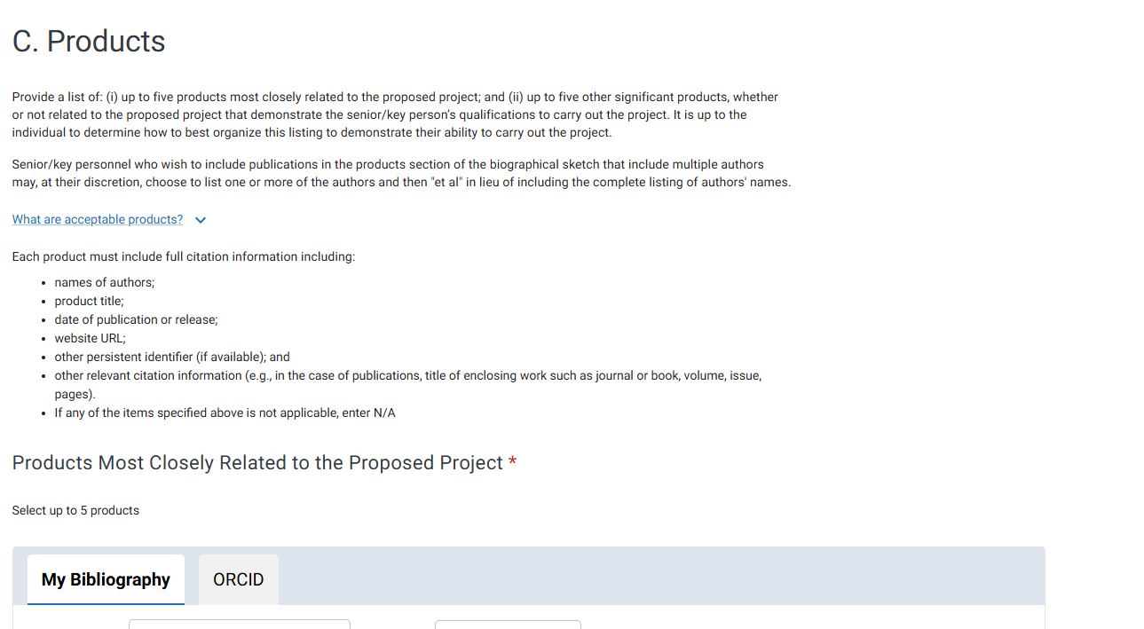
Adding products 2
Select products that you have entered manually or you can connect to your ORCID account

Slide 14
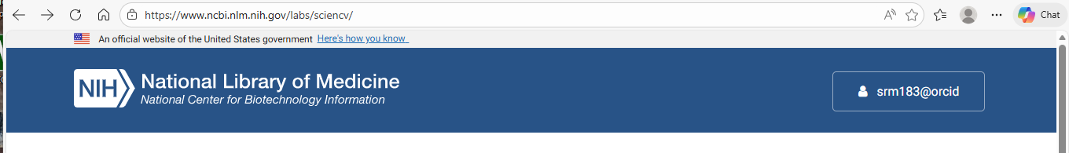
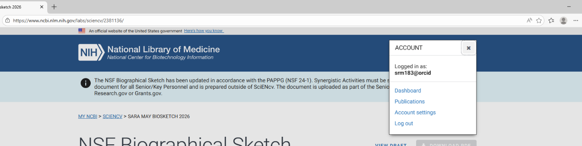
Adding products 3
To enter products manually click your name at the top of the screen and select publications

Slide 15
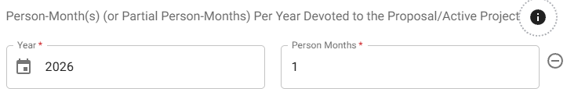
Creating the Current and Pending
Note this is not FTE but rather “person-month(s)

